Slide 1
Introduction to Reaction involving Substitution, Addition, Elimination, Oxidation and Reduction
NAME - SUSMITA SAGAR
ROLL NO - 202124

Slide 2
Substitution reaction
A substitution reaction (also known as single displacement reaction or single substitution reaction) is a chemical reaction during which one functional group in a chemical compound is replaced by another functional group.
Substitution reactions are of prime importance in organic chemistry.

Slide 3
.
Four factors affect the rate of the reaction:
Substrate.
Nucleophile.
Solvent.
Leaving group.

Slide 4
Polar protic solvents actually speed up the rate of the unimolecular substitution reaction because the large dipole moment of the solvent helps to stabilize the transition state. The highly positive and highly negative parts interact with the substrate to lower the energy of the transition state
Polar protic solvents are water, ethanol, methanol, ammonia, acetic acid, and others. Polar aprotic solvents contain no hydrogen atoms connected directly to an electronegative atom, and they are not capable of hydrogen bonding.

Slide 5

Chlorination of methane by chlorine

Slide 6
A good example of a substitution reaction is halogenation. When chlorine gas (Cl₂) is irradiated, some of the molecules are split into two chlorine radicals (Cl•) whose free electrons are strongly nucleophilic. One of them breaks a C–H covalent bond in CH₄ and grabs the hydrogen atom to form the electrically neutral HCl. The other radical reforms a covalent bond with the CH₃• to form CH₃Cl (methyl chloride).

Slide 7
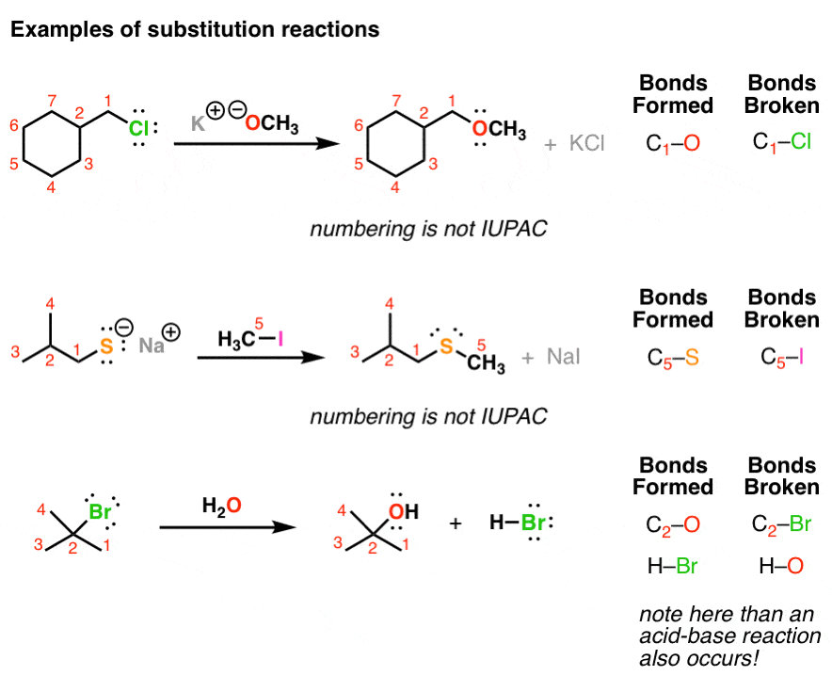

Slide 8
Addition Reaction
An addition reaction, in organic chemistry, is in its simplest terms an organic reaction where two or more molecules combine to form a larger one.
Addition reactions are limited to chemical compounds that have multiple bonds, such as molecules with carbon–carbon double bonds (alkenes), or with triple bonds (alkynes), and compounds that have rings, which are also considered points of unsaturation.
Molecules containing carbon—hetero double bonds like carbonyl (C=O) groups, or imine (C=N) groups, can undergo addition, as they too have double-bond character.
An addition reaction is the reverse of an elimination reaction. For instance, the hydration of an alkene to an alcohol is reversed by dehydration.

Slide 9
Reaction mechanism: Addition reactions Reaction in which a multiple bond between two atoms becomes partly or fully saturated by covalent attachments at both centers are called addition reactions. Many mechanisms are known for such reactions; most of them are variants of four basic mechanisms, which differ chiefly.
chemical compound: Addition reaction
The addition of one molecule to another to give a single new molecule constitutes an important class of reactions. Illustrative is the addition of chlorine to ethylene to give the dichloroethane used for the industrial production of vinyl chloride. Alcohols are commonly made

Slide 10
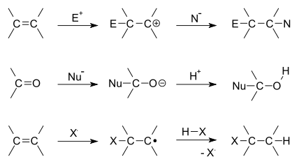
Top to bottom: electrophilic addition to alkene, nucleophilic addition of nucleophile to carbonyl and free-radical addition of halide to alkene.

Slide 11
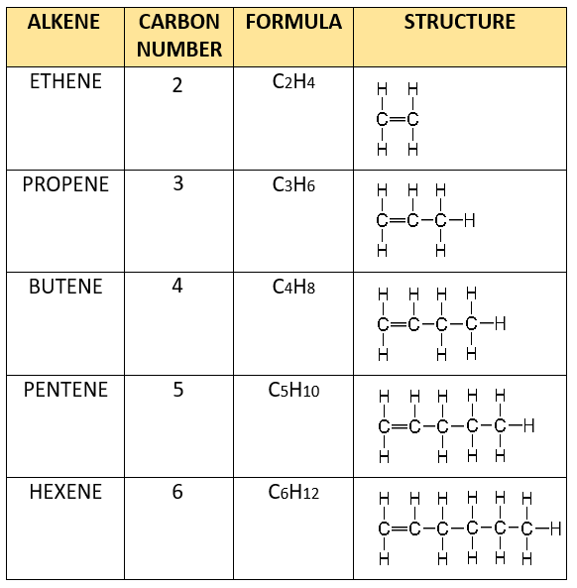
Compounds which give addition reaction

Slide 12

Elimination reaction
Elimination reaction, any of a class of organic chemical reactions in which a pair of atoms or groups of atoms are removed from a molecule, usually through the action of acids, bases, or metals and, in some cases, by heating to a high temperature. It is the principal process by which organic compounds containing only single carbon-carbon bonds (saturated compounds) are transformed to compounds containing double or triple carbon-carbon bonds (unsaturated compounds).

Slide 13
More about Elimination Reaction
Elimination reactions are commonly known by the kind of atoms or groups of atoms leaving the molecule.
The removal of a hydrogen atom and a halogen atom, for example, is known as dehydrohalogenation
when both leaving atoms are halogens, the reaction is known as dehalogenation.
Similarly, the elimination of a water molecule, usually from an alcohol, is known as dehydration
when both leaving atoms are hydrogen atoms, the reaction is known as dehydrogenation
. Elimination reactions are also classified as E1 or E2, depending on the reaction kinetics. In an E1 reaction, the reaction rate is proportional to the concentration of the substance to be transformed; in an E2 reaction, the reaction rate is proportional to the concentrations of both the substrate and the eliminating agent

Slide 14
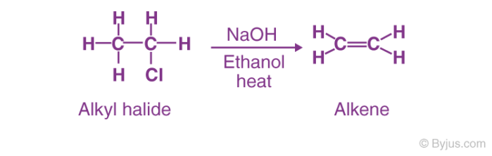
Example of Elimination reaction

Slide 15
Important Methods of Elimination Reaction
Elimination reactions are distinguished by the kind of atoms or groups of atoms that leave the molecule. Due to this, there are two main methods involved in this type of reaction;
Dehydration
Dehydrohalogenation
In the dehydration method, there is the elimination of a water molecule mostly from compounds such as alcohol. Sometimes, this method is also called Beta elimination reaction where the leaving group and H are placed at neighbour carbon atoms. On the other hand, in dehydrohalogenation, there is a removal of a hydrogen atom and a halogen atom.

Slide 16
What is Oxidation Reaction?
Oxidation may be defined as loss of electrons from a substance, the other definition of oxidation reactions states that the addition of oxygen or the more electronegative element or removal of hydrogen or the more electropositive element from a substance is called an oxidation reaction.
Following are some examples of oxidation reactions:
2S(s) + O₂ (g) → SO₂ (g) CH₄ (g) + 2O₂ (g) → CO₂ (g) + 2H₂O (l)

Slide 17
What is Reduction Reaction?
Like oxidation reactions, reduction reactions are defined as the gain of electrons. Any substance that gains electron during a chemical reaction gets reduced.
In other forms, the reduction reaction is stated as the addition of hydrogen or more electropositive element or removal of a more electronegative element or oxygen from a substance.
Below are some examples of reduction reactions:
2CH₂CH₂ (g) + H₂ (g) → CH₃CH₃ (g)
2FeCl₃ (aq) + H₂ (g) → 2FeCl₂ (aq) + 2HCl (aq)

Slide 18
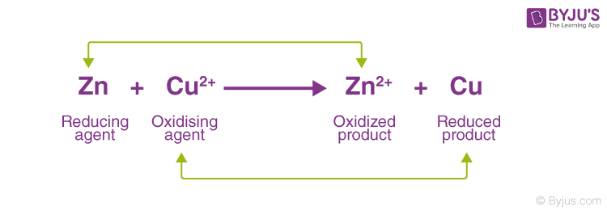
Oxidation-Reduction Reaction Example

Slide 19
Properties of redox reaction
An oxidation-reduction (redox) reaction is a type of chemical reaction that involves a transfer of electrons between two species.
An oxidation-reduction reaction is any chemical reaction in which the oxidation number of a molecule, atom, or ion changes by gaining or losing an electron.
Redox reactions are common and vital to some of the basic functions of life, including photosynthesis, respiration, combustion, and corrosion or rusting.

Slide 20
Oxidizing-Reducing agent
Redox reactions are comprised of two parts, a reduced half and an oxidized half, that always occur together. The reduced half gains electrons and the oxidation number decreases, while the oxidized half loses electrons and the oxidation number increases.
There is no net change in the number of electrons in a redox reaction
The two species that exchange electrons in a redox reaction are given special names:-
The ion or molecule that accepts electrons is called the oxidizing agent - by accepting electrons it oxidizes other species.
The ion or molecule that donates electrons is called the reducing agent - by giving electrons it reduces the other species.
Hence, what is oxidized is the reducing agent and what is reduced is the oxidizing agent. (Note: the oxidizing and reducing agents can be the same element or compound, as in disproportionation reactions discussed below).

